Slide 1

Flight Path
(Open source software)

Slide 2

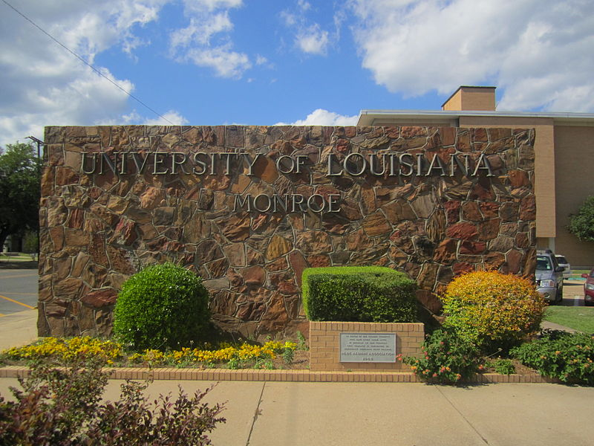
About flight path:
FlightPath is an open-source, web-based academic advising system designed for universities. Originally created by The University of Louisiana at Monroe, the software package was released as open-source on March 13, 2013.

Slide 3
Requirments:
1)MySQL
2)Apache
3)PHP
4)Linux, Unix Windows
5)Minimum of 1GB of RAM and 10GB hard disk space

Slide 4
Guildlines : 1) Ideas 2) what problem does it problem 3)Licensing model 4)Intend behind making it open source 5)Monitization model 6)Polularity 7) Impact

Slide 5
Idea:
FlightPath was created by The University of Louisiana at Monroe in 2006. It was designed to help standardize advising practices on campus, as well as provide a history of past advisings which students and advisors could review.
Since those early days, FlightPath has undergone several revisions, including a complete rebuild from scratch.
In March of 2013, the administration of ULM decided to release FlightPath as open source. Richard Peacock, one of the original developers, currently maintains the project and this site (getflightpath.com).
Other original developers and staff from ULM who worked on FlightPath were: Joe Mansour (Mainframe and Banner data coordinator), and Joann Perrer (degree and course data coordinator).

Slide 6
What problems does it solved:
To View student's transcript and degree plan, grades, etc.
To facilitate more accurate advising sessions on campus
Search complete set of degree plans
available

Slide 7
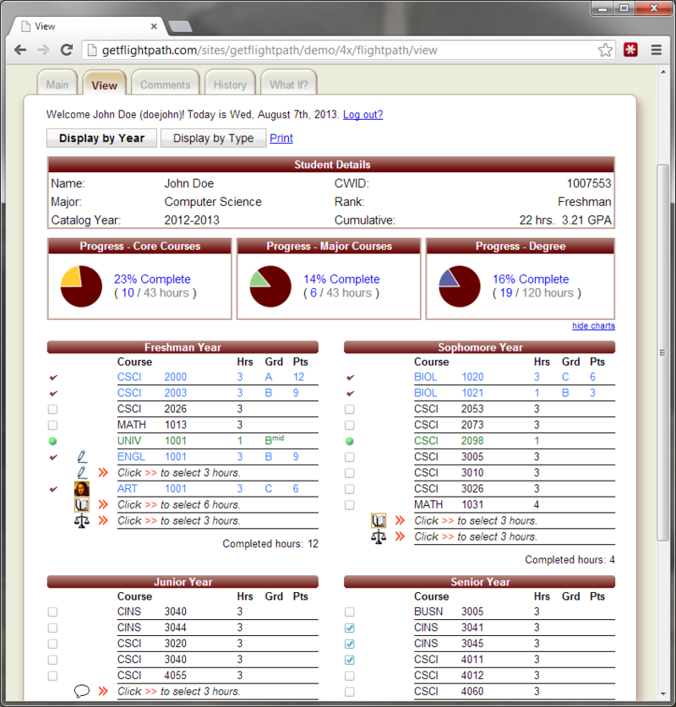

Slide 8

Licensing Model:
GNU General Public License (GNU GPL or GPL) is a widely used free software license, which guarantees end users the freedom to run, study, share and modify the software. The license was originally written by Richard Stalman of the Free Software Foundation(FSF) for the GNU Project, and grants the recipients of a computer program the rights of the Free Software Definition. The GPL is a copyleft license, which means that derivative work can only be distributed under the same license terms. This is in distinction to permissive free software licenses, of which the BSD licenses and the MIT License are widely used examples. GPL was the first copyleft license for general use.

Slide 9
Intent to making it open source:
FlightPath is distributed as an "open-source" software package. So, what exactly does that mean?
means that FlightPath may be download, modified, and put to use without having to pay for any license fees. It may even be redistributed, but only so long as it remains "open-source," under specific conditions outline here and in the COPYRIGHT.txt and LICENSE.txt files packed with FlightPath. The goal is to increase the amount of "free" software in the world, which is why FlightPath is being distributed in this manner.
There is a good chance that your school or university already uses some open source software. Perhaps your web site is run on a Linux server? Or you have applications installed such as Moodle, Zimbra, uPortal, or others? Maybe some of your desktop applications require Java to run, or you browse the web with FireFox? Or perhaps you benefit indirectly through the use of Google, Youtube, Facebook, or Wikipedia (all of which run on open source technologies).

Slide 10
Popularity:
As it was a University project it was most popular software among the users at the University of Louisiana at Monroe ,but fight path it not much popular globally.

Slide 11
Impact:
1)Students love it for its clean, friendly interface and features.
2)Advisers love it for its fool-proof advising, reporting, and auditing.
3)Administrators love it for its ease-of-use and money-saving solutions.

Slide 12

Public domian

Slide 13
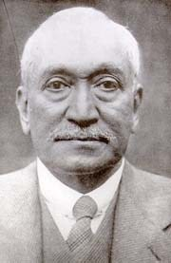
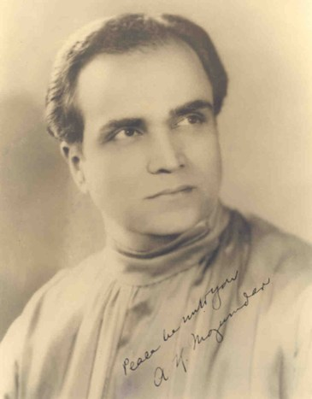
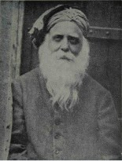
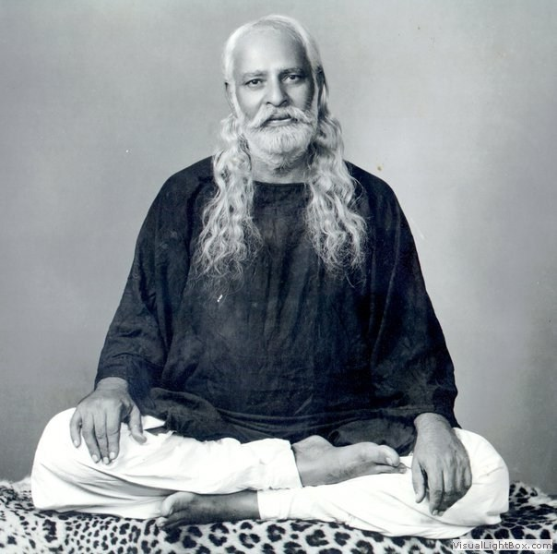


List of Public domain in India:Authors
Abdullah Yusuf Ali
Akhoy kumar mozumdar
Akali Kaur Singh
Ghulam Ali Rahim Bakhsh Masroor
Balijepalli Lakshmikantham
Girindrasekhar Bose

Slide 14
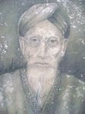

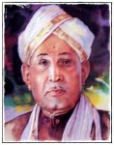

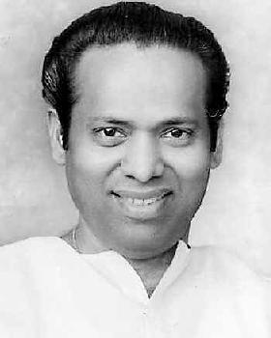
Hakim Syed Karam Husain
Halasangi Chennamallappa
M R Srinivasamurthy
V. R. Ramachandra Dikshitar
V. Kalyanasundaram

Slide 15
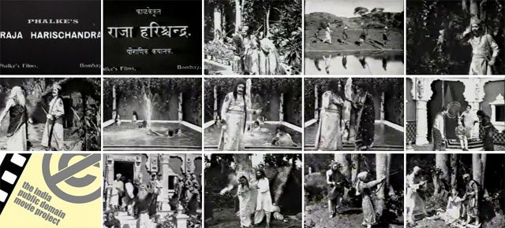
Movie:
Raja Harishchandra

Slide 16
Public domain ebooks:
ebooks | links
Project Gutenberg | http://www.gutenberg.org/
Authorama Public Domain Books | http://www.authorama.com/
Bartleby.com | http://www.bartleby.com
MIT OpenCourseWare | http://ocw.mit.edu/index.html
2,500 National Academy science, engineering, and health of USA texts free online�� | http://www.nap.edu

Slide 17
*Thank you ☺*

